Slide 2
Unit Objectives
Create a new page
Import text
Set text properties
Create an unordered list
Understand Cascading Style Sheets
Create a rule in a new Cascading Style Sheet
Apply and edit a rule
Add rules to a Cascading Style Sheet
Attach a Cascading Style Sheet to a page
Check for spelling errors

Slide 3
Creating a New Page
Start Dreamweaver, open The Striped Umbrella Web site
Create a new blank HTML page
Click File on the Menu bar, click New, click Blank Page
Click HTML in the Page type column, click <none> in the Layout column
Click the Doctype list box, click HTML 5, click Create, then click the Show Design view button if necessary
Click the Insert bar menu, click Common, click the Images list arrow, then click Image
Browse to and open the website assets folder, double-click su-banner.gif, type The Striped Umbrella banner in the Alternate text box in the image tag Accessibility Attributes dialog box, then click OK

Slide 4
Creating a New Page
Click to the right of the banner to deselect it
(Win) press [enter]
(Mac) press [Return]
Repeat step 4 to open the select image source dialog box, then navigate to the assets folder in your unit_d Data Files folder
Double-click sea-spa_logo.png, type The Sea Spa logo in the Alternate text box in the image tag Accessibility
Click to the right of the logo to place the insertion point on the spa.html page

Slide 5
Creating a New Page

Slide 6
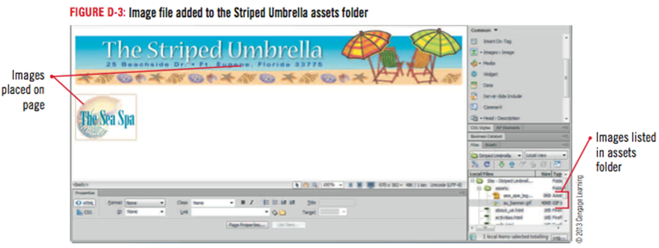
Creating a New Page

Slide 7
Importing Text
Import text
(Win) Click File on the Menu bar, point to import, click Word Document, browse to the folder where you store your Unit D Data Files, then double-click spa.doc
Import text
(Mac) Using Finder, navigate to spa.doc stored in your unit_d data files folder, open spa.doc, select all, copy, close spa.doc, then paste the copied text on the spa page in Dreamweaver
Click commands on the Menu bar, then click clean up Word HTML
Click to select each check box in the clean Up Word HTML dialog box if necessary, click OK, then click OK again

Slide 8
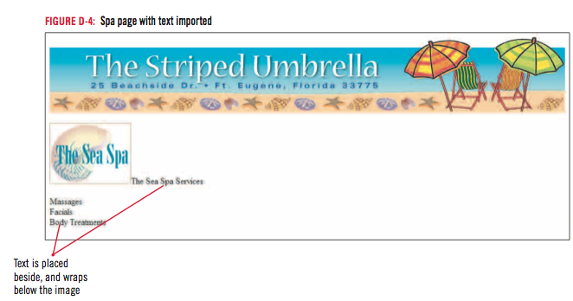
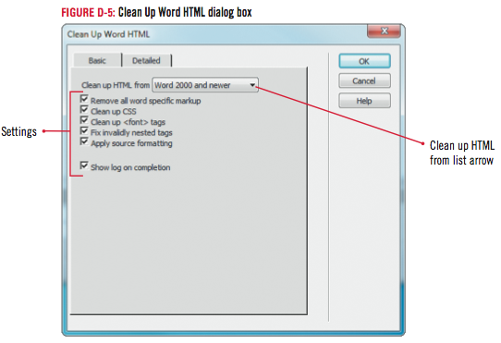
Importing Text

Slide 9
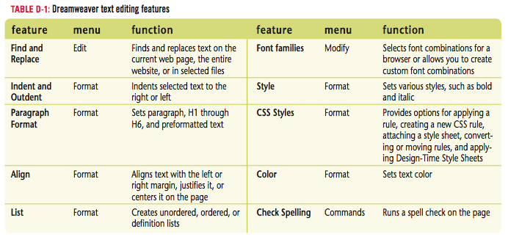
Importing Text

Slide 10
Clues to Use
Importing options
Use with Microsoft Office documents
Import:
Text only
Text with structure
Text, structure, basic formatting
Text, structure, full formatting
Option chosen depends on importance of original structure and formatting

Slide 11
Clues to Use
Linking to Word or Excel documents
Drag the Word or Excel document from its current location to the place on the page you want the link to appear
Select the Create a link option button in the Insert Document dialog box, then save the file in your local site root folder so it will be uploaded when you publish your site

Slide 12
Setting Text Properties
Click the HTML button on the Property inspector if necessary, then click anywhere within the words The Sea Spa Services
Click the Format list arrow, then click Heading 1
Repeat steps 1 and 2 to add the Heading 2 style to Massages, Facials, and Body Treatments right under the logo
Click after the word “Treatments”, insert a line break, click the Show Code and Design views button on the Document toolbar
Click the Show Design view button on the Document toolbar, then save your work

Slide 13
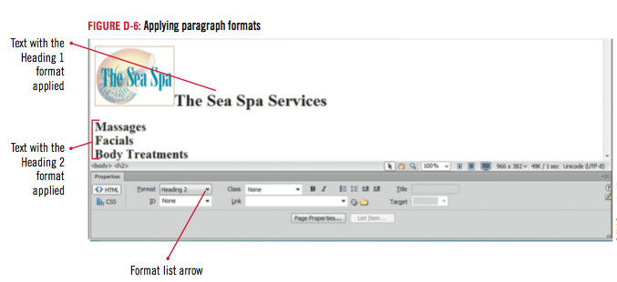
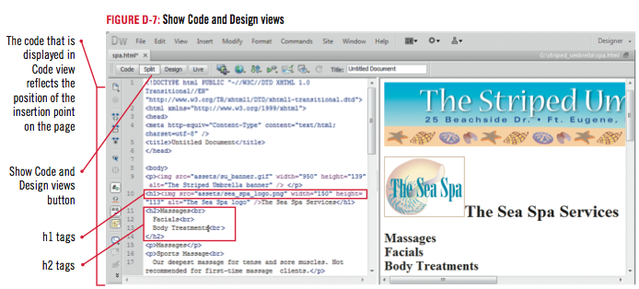
Setting Text Properties

Slide 14
Design Matters
Choosing fonts
Sans-serif fonts are made up of plain characters without any strokes at the top and bottom of letters
Used frequently for headings and subheadings in printed text
Serif fonts are more ornate, with small extra strokes at the top and bottom of the characters
Easier to read in printed material because the extra strokes lead your eye from one character to the next

Slide 15
Creating an Unordered List
Select the three service items and their descriptions under the Massages heading
Click the Unordered List button on the HTML Property inspector, then deselect the text
Repeat steps 1 and 2 to create unordered lists of the spa service items under the Facials and Body Treatments headings
Click to place the insertion point before the first item in the first unordered list, then click the Show Code view button on the Document toolbar
Click the Show Design view button on the Document toolbar to return to Design View, then save your work

Slide 16
Creating an Unordered List

Slide 17
Design Matters
Coding for the semantic web
Semantic web refers to the way page content, such as paragraph, text, or list items, can be coded to emphasize their meaning to users
Semantic markup, or coding to emphasize meaning, is a way to incorporate good accessibility practice
CSS styles affect the appearance of web page content while semantic markup enhances the meaning of the content

Slide 18
Clues to Use
Using ordered lists
Contain numbered or lettered items
Must appear in a particular order
Dreamweaver uses several options for number styles
Roman
Arabic

Slide 19
Understanding Cascading Style Sheets
Advantages of using CSS
Save time
Provide continuity across a website
CSS classified by location
External style sheet
Internal style sheet
Embedded style
Inline style

Slide 20
Understanding Cascading Style Sheets
CSS classified by function
Class style
HTML style
Advanced or Compound style
The CSS Styles panel
Use the CSS Styles panel to create, edit, and apply rules
The panel has two views:
All (Document) Mode
Current Selection Mode

Slide 21
Understanding Cascading Style Sheets

Slide 22
Understanding Cascading Style Sheets

Slide 23
Clues to Use
Using the CSS and HTML Property inspector
Apply CSS styles using the CSS or HTML Property inspector
First select the element
Apply a style
You can change back and forth between the two Property inspectors

Slide 24
Creating a Rule in a New Cascading Style Sheet
Click Window on the Menu bar
Click the Switch to All (Document) Mode button under the CSS styles panel tab
Click the New CSS Rule button on the CSS Styles panel
Click the Selector Type list arrow, select Class, then type bold_blue in the Selector Name text box
Click the Rule Definition list arrow, click (New Style Sheet File), click OK
Type su_styles in the File name text box (Win) or the Save As text box (Mac), then click Save

Slide 25
Creating a Style in a New Cascading Style Sheet
Click the Font-family list arrow
Click Arial, Helvetica, sans-serif
Click Font-size list arrow, click 14
Keep size measurement as px
Click Font-style list arrow, click normal
Click Font-weight list arrow, click bold
Click the Color box to open the color picker, click #006, then click OK, then click the Refresh button on the Files panel
Click the Show Code view button on the Document toolbar
Click File on the Menu bar, then click Save All

Slide 26
Creating a Style in a New Cascading Style Sheet

Slide 27
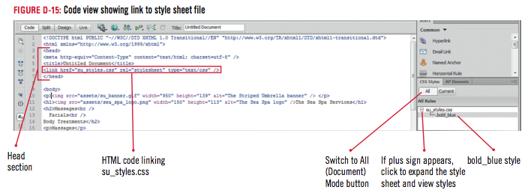
Creating a Style in a New Cascading Style Sheet

Slide 28
Applying and Editing a Rule
Click the Show Design view button on the Document toolbar
Then click the CSS button
Select Massages, click the Targeted Rule list arrow in the CSS Property inspector, click bold_blue
Repeat Step 2 to apply the bold_blue style to the Facials and Body Treatment unordered list headings
Click the bold_blue rule in the CSS Styles panel, then click the Edit Rule button on the CSS Styles panel
Click the Font-size arrow, click 16, click OK, then deselect the text
Save your work using the Save All command

Slide 29
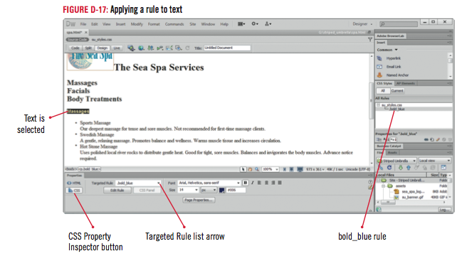
Applying and Editing a Style

Slide 30
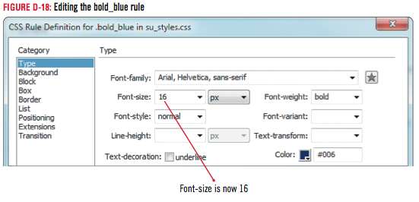
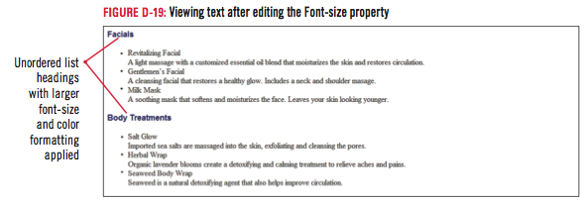
Applying and Editing a Style

Slide 31
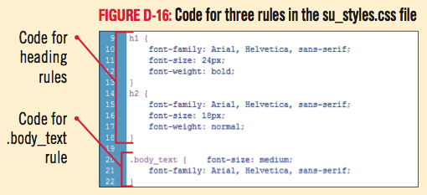
Clues to Use
Understanding CSS Code
Format page content other than text
Background, borders, lists, and images
CSS Styles consist of a selector and a declaration

Slide 32
Adding Rules to a Cascading Style Sheet
Click the New CSS Rule button on the CSS Styles Panel
Click the Selector Type list arrow, click Tag (redefines an HTML element)
Type h1 in the Selector Name text box, click the Rule Definition list arrow
Click su_styles.css, then click OK
Click the Font-family list arrow, then click Arial, Helvetica, sans-serif, click the Font-size list arrow, click 24, click the Font-weight list arrow, click bold

Slide 33
Adding Rules to a Cascading Style Sheet
Repeat steps 1 through 3 to create a rule to modify the <h2> tag using the following settings: Font-family: Arial, Helvetica, sans-serif; Font-size: 18; Font-weight: normal
Click File on the Menu bar, then click Save All

Slide 34
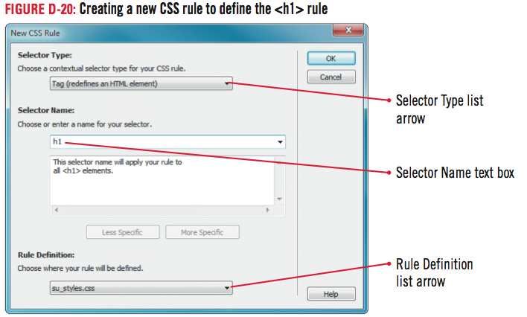
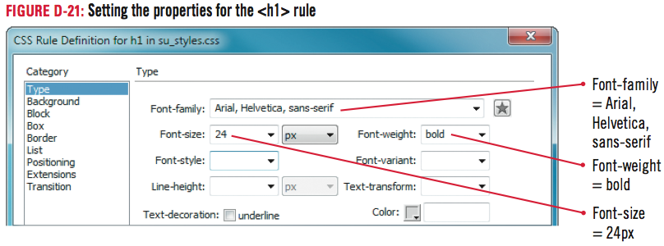
Adding Rules to a Cascading Style Sheet

Slide 35
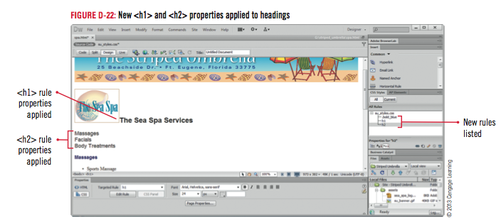
Adding Rules to a Cascading Style Sheet

Slide 36
Clues to Use
Using font combinations in styles
When setting rule properties for text:
Apply font combinations
Ensures similar font will be applied if primary one is unavailable
Example: Arial, Helvetica, sans-serif
Browser will first check the user’s system for Arial, then Helvetica, etc.
Another option is external font libraries

Slide 37
Attaching a Cascading Style Sheet to a Page
Open the index.html page
Click the Attach Style Sheet button on the CSS Styles panel
Click Browse next to the File/URL text box
Click su_styles.css in the Select Style Sheet File dialog box if necessary
Click OK (Win) or Open (Mac), then click OK
Right-click the body_text rule under <style> in the CSS Styles panel in the internal style sheet, click Move CSS Rules, click OK

Slide 38
Attaching a Cascading Style Sheet to a Page
Repeat step 4 to move the nav_bar, small_text, and body rules to the external style sheet, delete the remaining <style> tag in the CSS Styles panel, save all files, then close the index page
Select the first unordered list on the spa page, click the Targeted Rule text box on the CSS Property inspector, then click body_text
Repeat step 6 to apply the body_text rule to the rest of the text on the page that does not have a rule applied, click File on the Menu bar, then click Save All

Slide 39
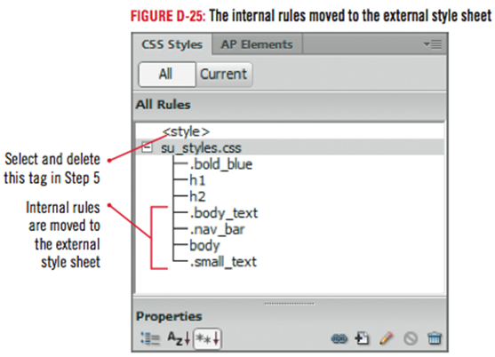
Attaching a Cascading Style Sheet to a Page

Slide 40
Design Matters
The evolution of CSS3
Cascading Style Sheets revisions are referenced by “levels” rather than “versions”
CSS Level 1 is obsolete today. CSS Level 2 is still used, but CSS Level 3 is the latest W3C (World Wide Web Consortium) standard
With CSS3, several properties are available that promote website accessibility such as the @font-face rule

Slide 41
Checking for Spelling Errors
Place the insertion point in front of The Sea Spa Services heading
Click Commands on the Menu bar, then click Check Spelling
Click massage. in the Suggestions list if necessary, click Change, then click Ignore if it stops on any other words that you know are spelled correctly
Click OK

Slide 42
Checking for Spelling Errors
Add the page title The Sea Spa to the Title text box on the Document toolbar
Click File on the Menu bar, click Save, click the Preview/Debug in browser icon, then preview the spa page in your browser window
Close your browser, close all open pages, then exit Dreamweaver

Slide 43
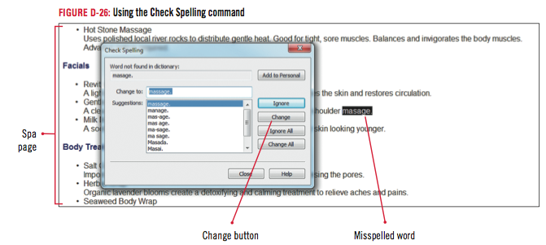
Checking for Spelling Errors

Slide 44
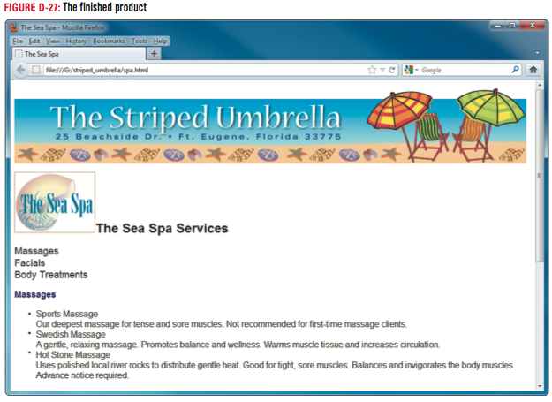
Checking for Spelling Errors

Slide 45
Clues to Use
Using Find and Replace
Located on the Edit menu
Search for text in Design or Code view
Similar to Find and Replace commands in word processing programs
Useful to search for coding errors

Slide 46
Unit Summary
Create a new page
Import text
Set text properties
Create an unordered list
Understand Cascading Style Sheets
Create a rule in a new Cascading Style Sheet
Apply and edit a rule
Add rules to a Cascading Style Sheet
Attach a Cascading Style Sheet to a Page
Check for spelling errors

